Slide 1

INDUS BLIND DOLPHINS by

Slide 2
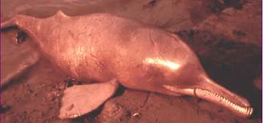
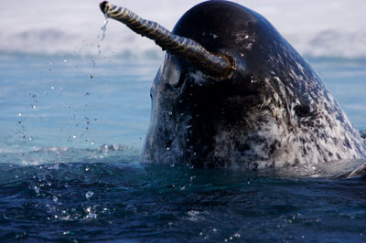

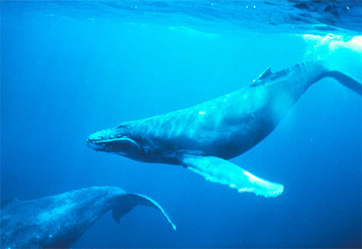
Cetacean
The Cetacea are one of the most distinctive and highly specialized orders of mammals.
They include the largest animal that has ever lived, the blue whale; the highly intelligent and communicative dolphins; the tusked narwhales and blind river dolphins and singing humpback whales.
Blind river dolphins
Tusked Narwhales
Blue whale
Singing Humpback whales

Slide 3
TYPES OF CETACEAN
Porpoises
Dolphins
Whales
Seventy-nine species of cetaceans (whales, dolphins and porpoises) inhabit in the world, among which 75 species live in the sea

Slide 4
Dolphins
Among aquatic mammals, dolphins are the most advanced and adapted to aquatic life.
Dolphins are the closest relatives of hippopotamus, camel
The Dolphin is a mammal with close association to the whale and porpoise .The name 'Dolphin' may have come from the ancient Greek term 'Delphis‘ which means'with a womb'. Therefore, the meaning of the word 'Dolphin' may mean 'fish with a womb'.
Dolphin are known to be the most intelligent creatures on earth. The brain of the dolphin weighs 1500-1700 grams, while the human brains weighs 1200 grams.
These marine mammals are mostly believed to have been evolved from land mammals, some 50 or 60 million years ago.

Slide 5
SOME TYPES OF DOLPHIN
Other Types Of Dolphin
Oceanic Dolphins
River Dolphin
Bottlenose dolphin
Dusky dolphin
Risso's dolphin
Hector's dolphin
Long-snouted spinner dolphin
Peale's dolphin
Clymene dolphin
Long-beaked common dolphin
Short-beaked common dolphin
Commerson's dolphin
Hourglass dolphin
Pantropical dolphin
Frasier's dolphin
Irrawaddy dolphin
Rough-toothed dolphin
Atlantic spotted dolphin
Atlantic white-sided dolphin
Pacific white-sided dolphin
Indo-Pacific humpback dolphin
White Beaked Dolphin
Striped Dolphin
Black Dolphin
Heaviside's Dolphin
Melon-Headed Dolphin
Amazon River Dolphin
Yangtze or Baiji River Dolphin
Ganges Dolphin
Indus River Dolphin
La Plata dolphin

Slide 6
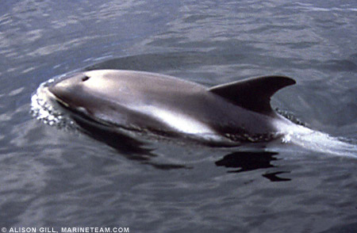
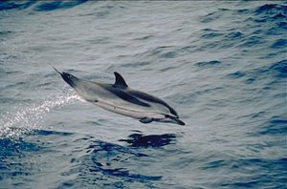
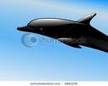
Oceanic Dolphins
White Beaked Dolphin
Striped Dolphin
Black Dolphin

Slide 7
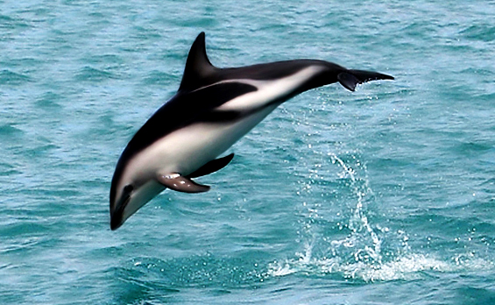
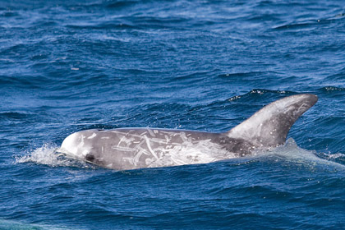
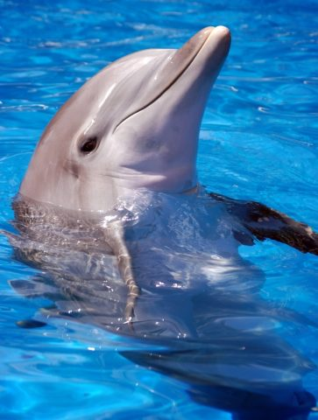
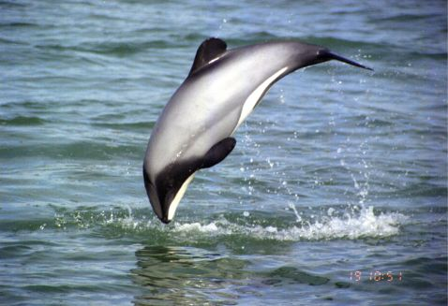
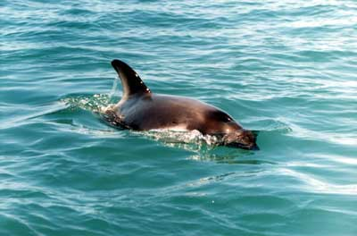
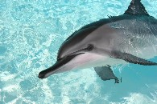
Other Types Of Dolphin
Bottle Nose Dolphin
Dusky Dolphin
Risso's Dolphin
Hector's Dolphin
Long-snouted spinner Dolphin
Peale's Dolphin

Slide 8

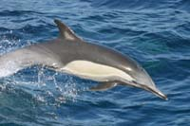
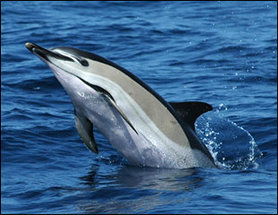
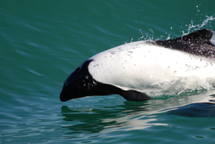
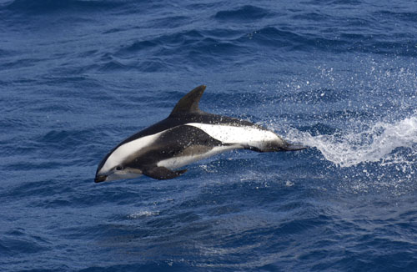
Other Types Of Dolphin
Clymene Dolphin
Short-beaked common Dolphin
Long-beaked common Dolphin
Commerson's Dolphin
Hourglass Dolphin

Slide 9
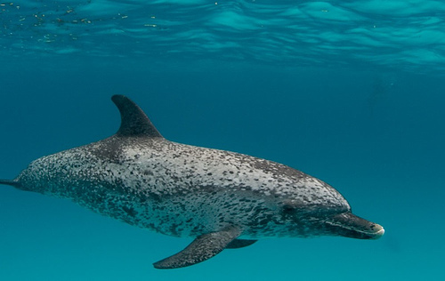
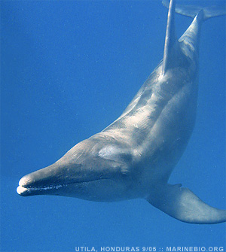
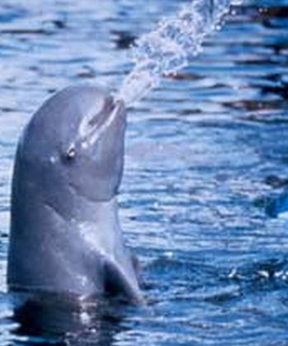
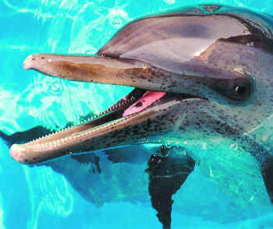
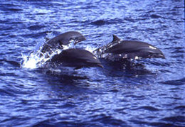
Other Types Of Dolphin
Atlantic spotted Dolphin
Rough-toothed Dolphin
Irrawaddy Dolphin
Pantropical Dolphin
Frasier's Dolphin

Slide 10

THANK YOU

